Slide 1
Statistics for Data Science

Slide 2
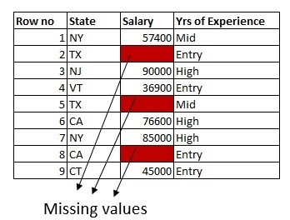

Slide 3
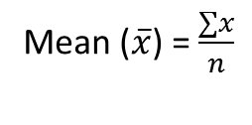
Mean
The most basic estimate of location is the mean, or average value. The mean is the sum of all the values divided by the number of values.
Consider the following set of numbers: {3 5 1 2}. The mean is (3 + 5 + 1 + 2) / 4 = 11 / 4 = 2.75.
You will encounter the symbol x (pronounced “x- bar”) to represent the mean of a sample from a population. The formula to compute the mean for a set of n values x1,x2,x3,… xn

Slide 4
A={1,2,3,4,5,6,7}
Mean value= (1+2+3+4+5+6+7 ) / 7
= 28/7
= 4
b={1,2,3,4,5,6,90}
= 111/7
= 33.857

Slide 5
Median
The Median : Arrange the observed values of variable in a data in increasing order.
• If the number of observation is odd, then the sample median is the observed value exactly in the middle of the ordered list. • If the number of observation is even, then the sample median is the number halfway between the two middle observed values in the ordered list.
Example: 13, 18, 13, 14, 13, 16, 14, 21, 13
The median is the middle value, so first I'll have to rewrite the list in numerical order13, 13, 13, 13, 14, 14, 16, 18, 21. So the median is 14.

Slide 6
Mode
The Mode : The sample mode of a qualitative or a discrete quantitative variable is that value of the variable which occurs with the greatest frequency in a data set.
Obtain the frequency of each observed value of the variable in a data and note the greatest frequency.
• If the greatest frequency is 1 (i.e. no value occurs more than once), then the variable has no mode. • If the greatest frequency is 2 or greater, then any value that occurs with that greatest frequency is called a sample mode of the variable.

Slide 7
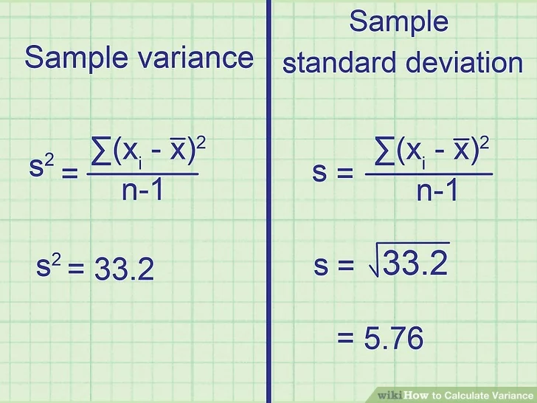
Variance

Slide 8
Standard deviation
Standard Deviation : For a variable x, the sample standard deviation, denoted by sx (or when no confusion arise, simply by s), is
Since the standard deviation is defined using the sample mean x of the variable x, it is preferred measure of variation when the mean is used as the measure of center (i.e. in case of symmetric distribution). Note that the stardard deviation is always positive number, i.e., Sx >= 0.

Slide 9
